Slide 1

Health Information System
Software Engineering Intern Task
Denis Nganga

Slide 2
Challenge Overview
Problem
Doctor Actions
Simulate a basic health information system
Create health programs
Secure doctor access using authentication
Register clients
Enroll clients into programs
Search clients
View profiles & expose via API

Slide 3





Approach
API-First
Secure RESTful APIs
React.js Frontend
Authentication
Clean, modular, and scalable codebase

Slide 4
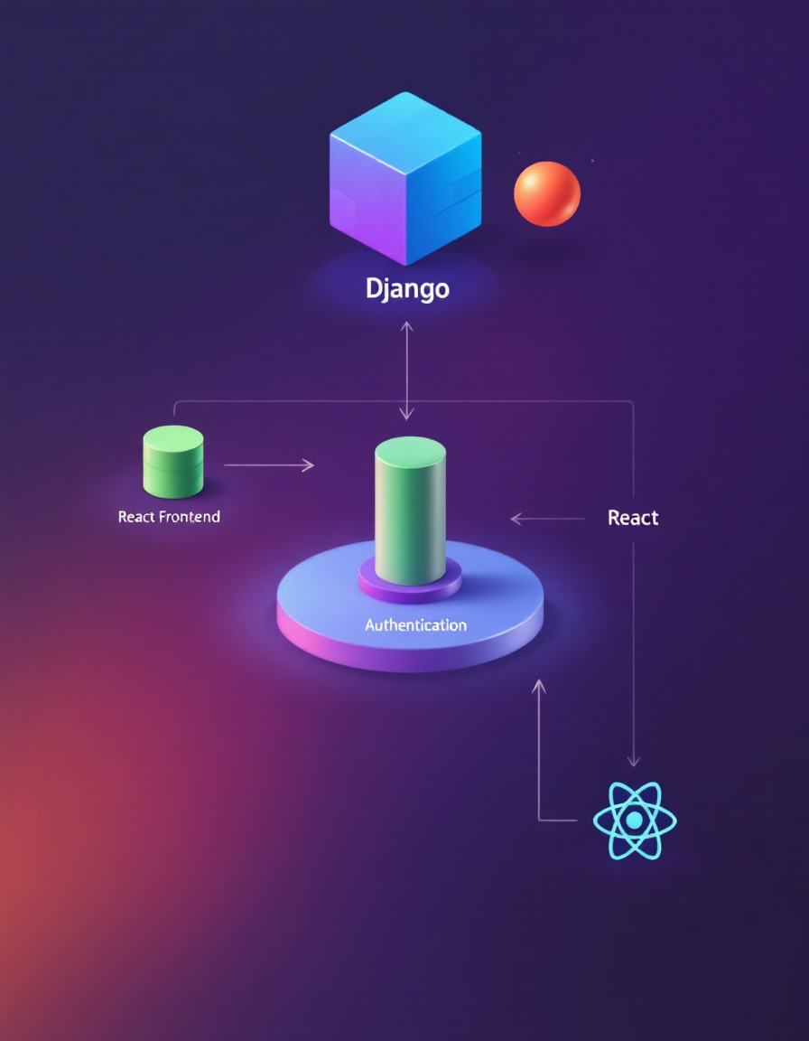




System Design
Django Backend
APIs with authentication
React Frontend
Protected routes, API consumption
Database
SQLite
Authentication
JWT Tokens

Slide 5
Key Features
Doctor Authentication
Health Program Management
Create Programs
Client Registration
Client Enrollment
Enroll into programs
Client Search & Profiles
API Endpoints
Detailed profile data
Authenticated access

Slide 6
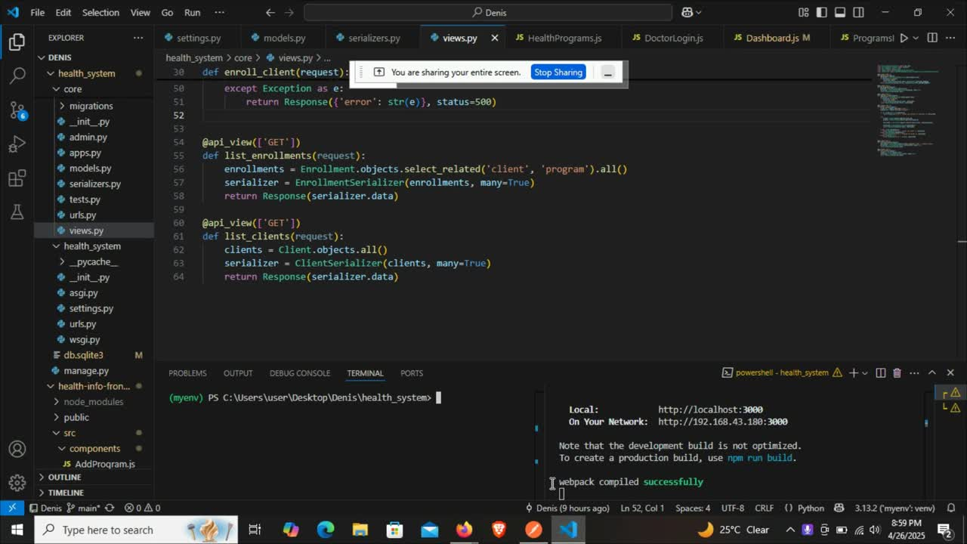
Prototype Demonstration

